Slide 1
3: Authored Behaviours II: emergence
COMP702: Classical Artificial Intelligence

Slide 2
Paper Club
For next week’s seminar, please read:
Grow, A., Gaudl, S., Gomes, P., Mateas, M., & Wardrip-Fruin, N. (2014). A Methodology for Requirements Analysis of AI Architecture Authoring Tools. Proceedings of Foundations of Digital Games Conference.
(PDF Link on LearningSpace)

Slide 3
Emergence

Slide 4
What is emergence?
When something has a property that its parts alone do not have
The whole is different from the sum of its parts

Slide 5

A pile of sand
Composed of many thousands of grains
The size and weight of the pile comes from the sum of the individual grains → not emergent
The slope of the pile comes from interaction of the grains with friction and gravity → emergent

Slide 6
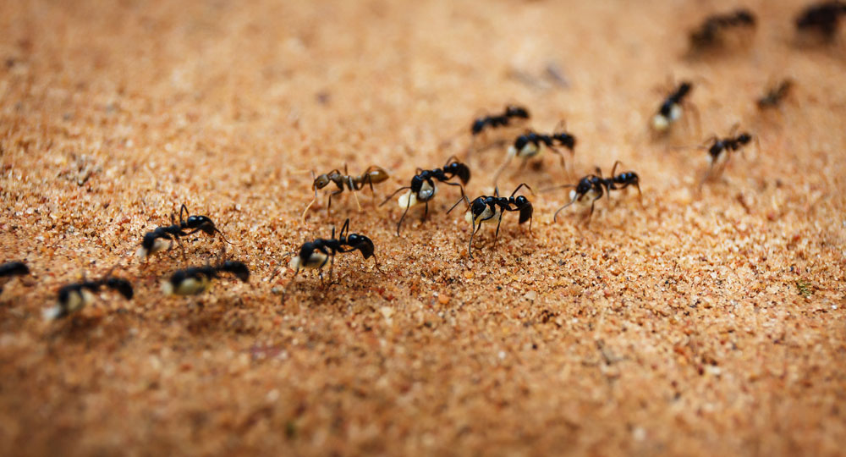
Ants
The ant queen is not in charge!
Individual ants react to stimulus (scent)
Ants “coordinate” through stigmergy
Coordination by altering the environment
Ants lay pheromones, which other ants react to
Complex behaviours (building nests, finding food, removing waste) emerge from simple behaviours by individual ants

Slide 7
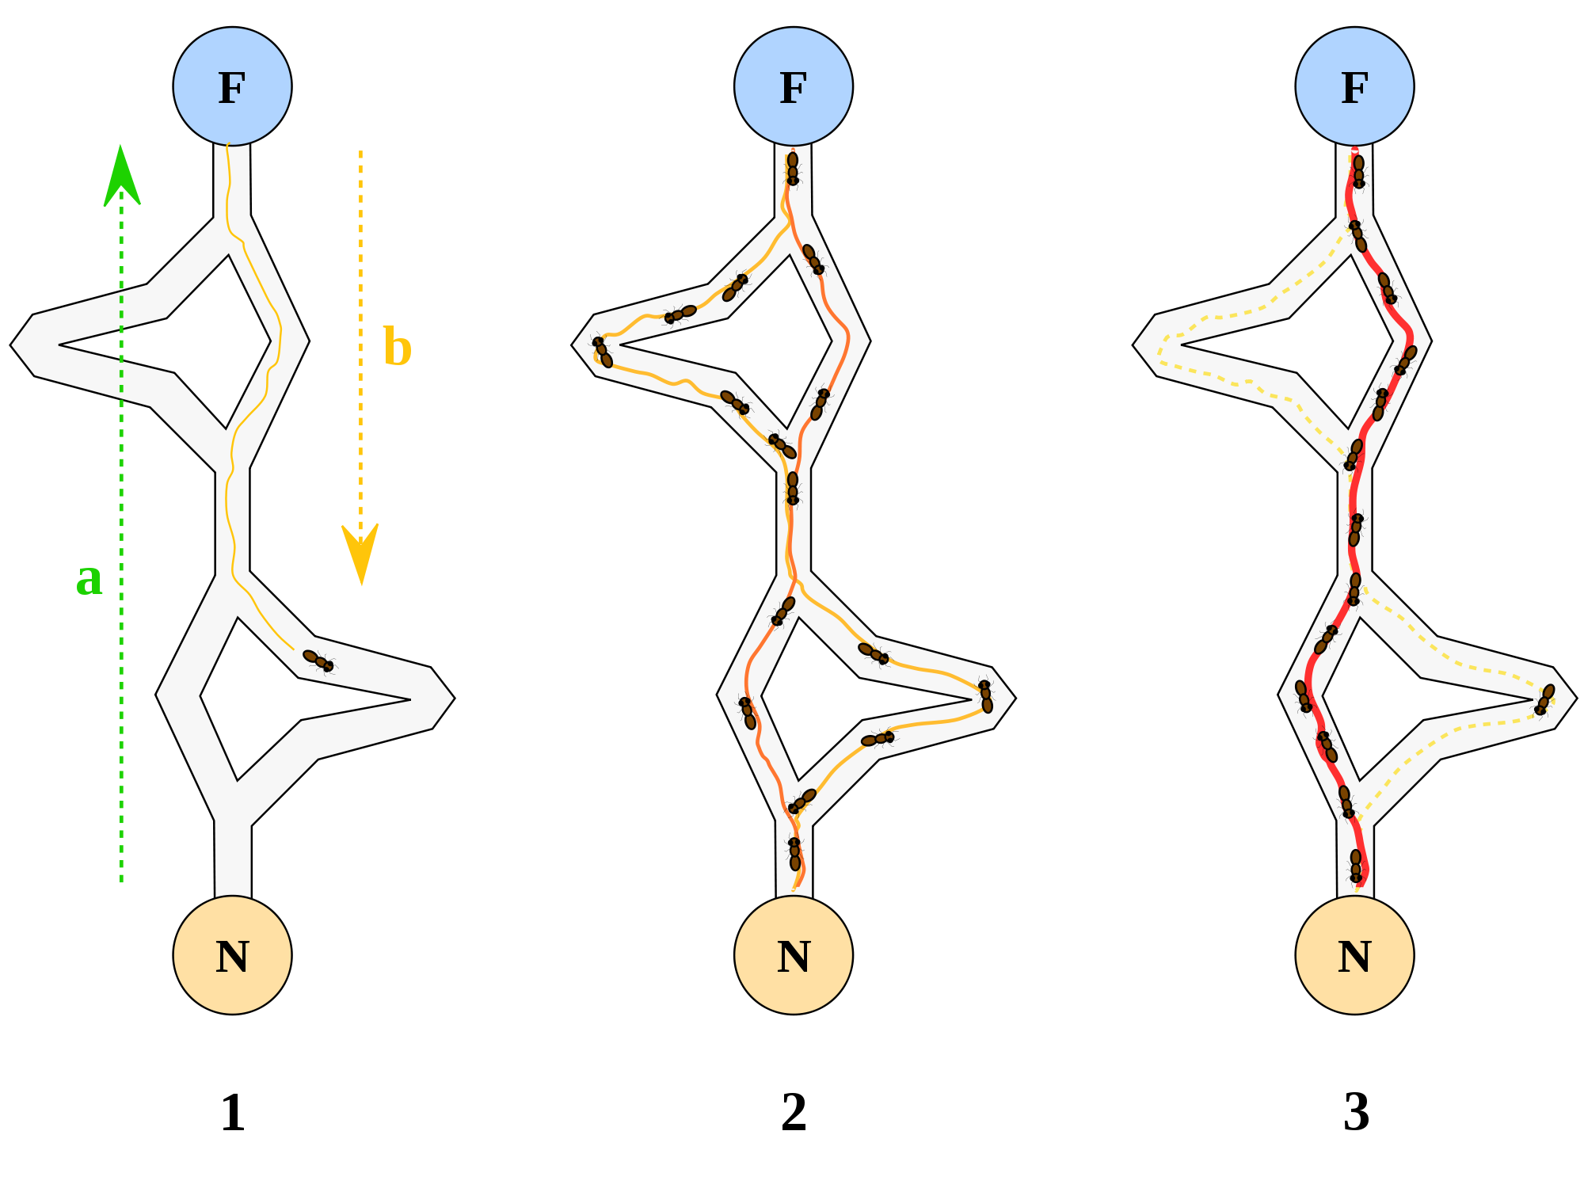
Ant colony optimisation
How real ants find food:
Wander randomly
On finding food, return to the nest (laying pheromones)
If there is a pheromone trail, follow it (but not perfectly)
Algorithms inspired by this can be used for pathfinding, travelling salesman problems, network routing, …

Slide 8
Flocking, schooling, herding
Many animals exhibit complex group behaviours
Flocking in birds
Schooling in fish
Herding in land mammals
Arising from simple behaviours
There is no “leader” or “commander”

Slide 9
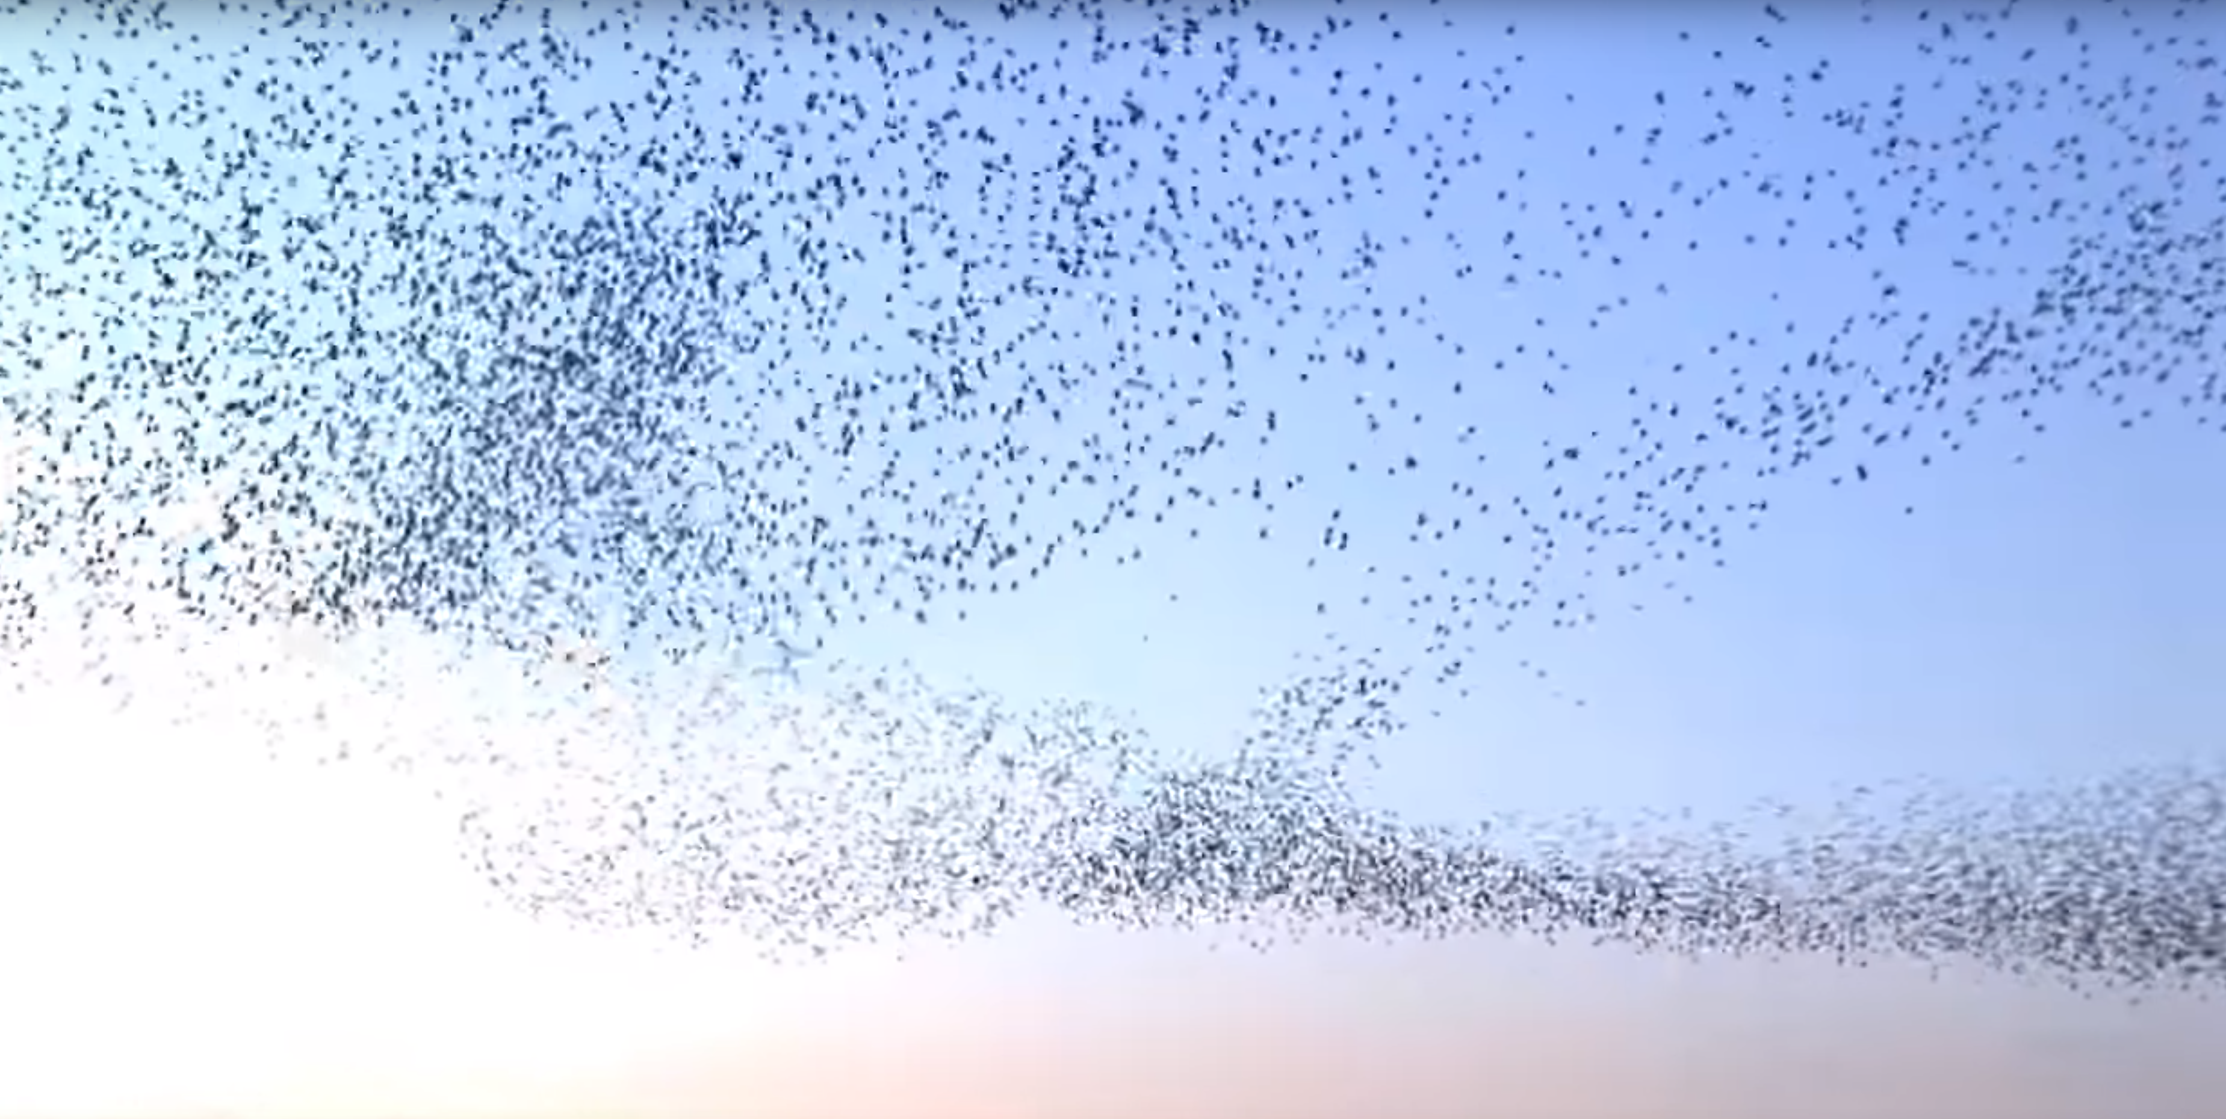
Starlings
https://www.youtube.com/watch?v=eakKfY5aHmY

Slide 10
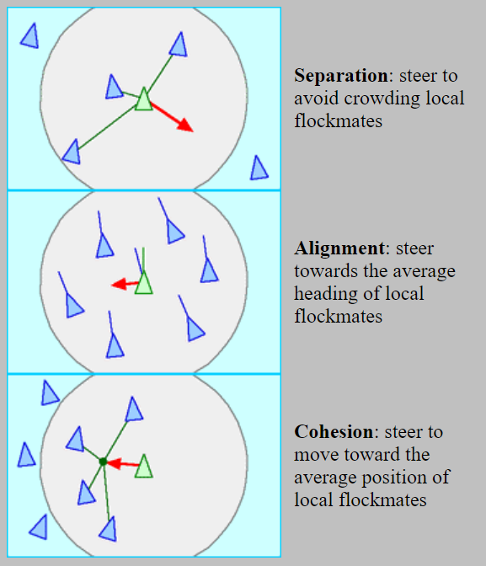
Boids
Developed by Craig Reynolds in 1986
Based on three simple rules: separation, alignment and cohesion
Can also add obstacle avoidance, danger avoidance, goal seeking

Slide 11
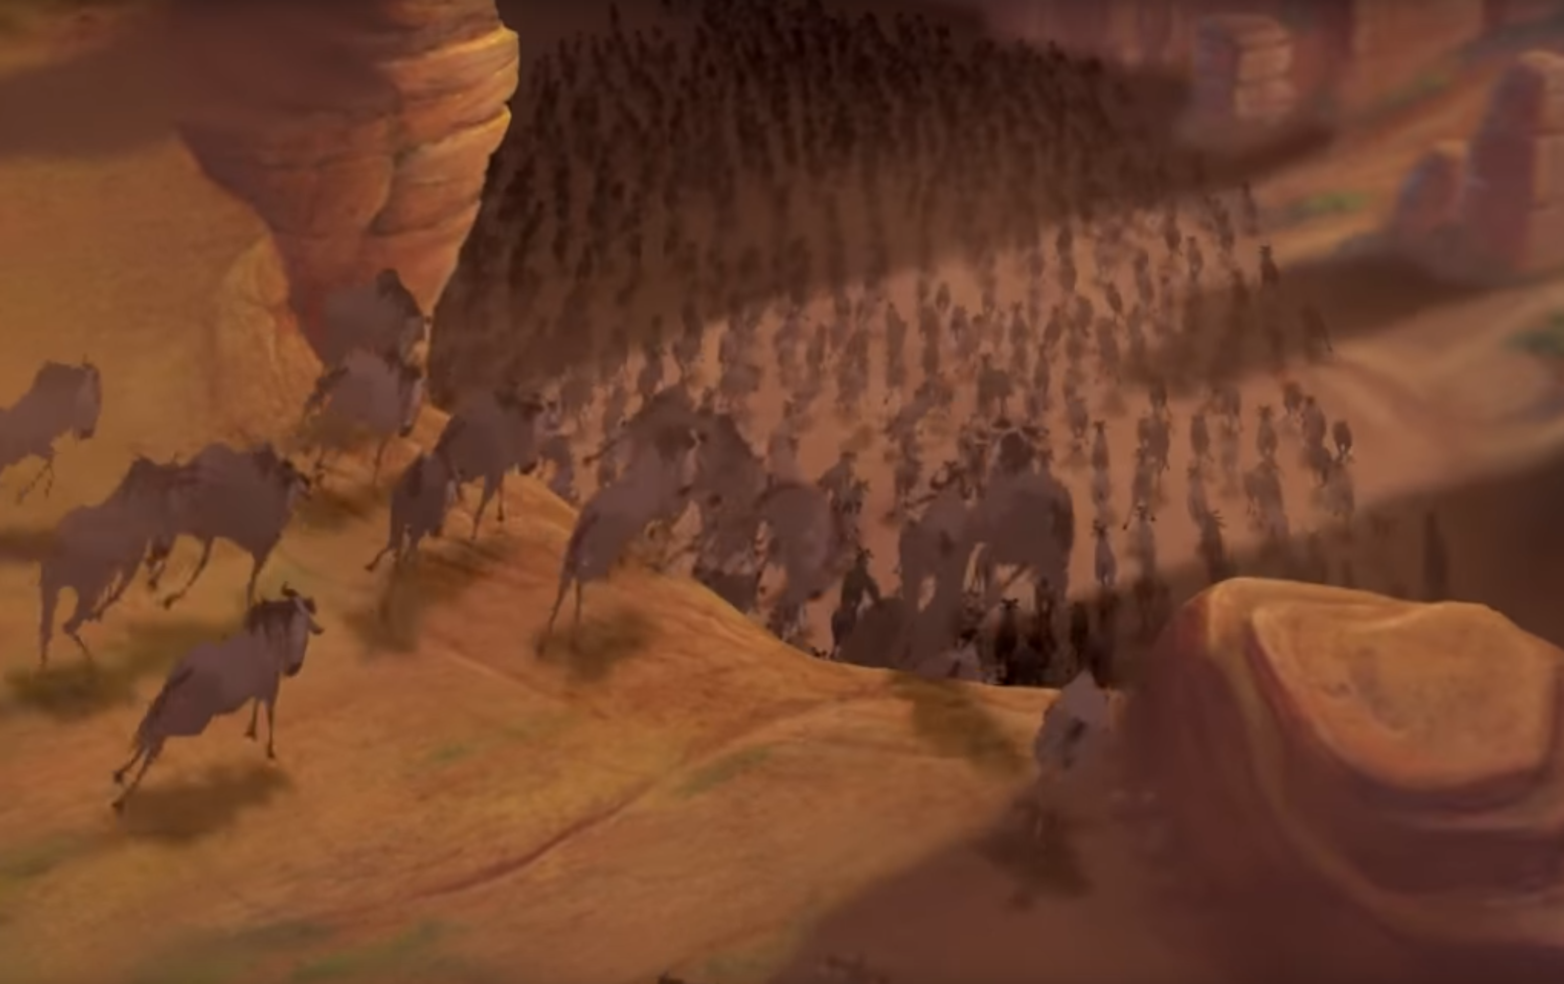
Simulated stampede in The Lion King (1994)
https://youtu.be/FbLA0LS67XE?t=74
https://youtu.be/HLmAT6t5kL0

Slide 12

Simulated crowds in Hitman: Absolution (2012)
https://www.gdcvault.com/play/1016443/Crowds-in-Hitman

Slide 13
Cellular Automata
A lattice of cells
Each cell has a state
Update rule applied to each cell every time step: gives new state of the cell as a function of the old state of the cell and its neighbours

Slide 14
Conway’s Game of Life
Each cell has state 0 or 1
A cell enters state 1 if:
Its state is 0 and exactly 3 of its neighbours are in state 1
Its state is 1 and exactly 2 or 3 of its neighbours are in state 1
Otherwise it enters state 0
https://www.samcodes.co.uk/project/game-of-life/

Slide 15
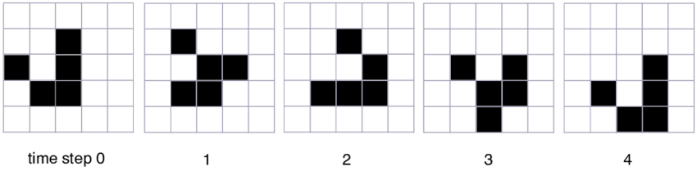
Gliders
This pattern of cells appears to move down and to the right every 4 time steps
The cells themselves don’t move
The update rule just happens to give the illusion of movement

Slide 16
Conway’s game of Life
Many interesting emergent behaviours come from the simple rules of Conway’s Game of Life
It is possible to construct logic gates from interactions of gliders
Conway’s Game of Life is Turing complete!

Slide 17

Other cellular automata
Cave erosion (useful for PCG)
Traffic simulation
Fluid simulation
…

Slide 18
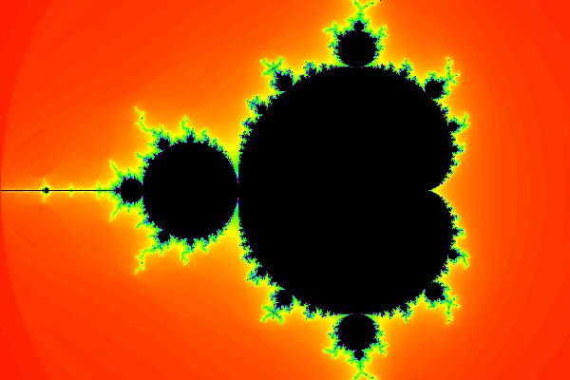
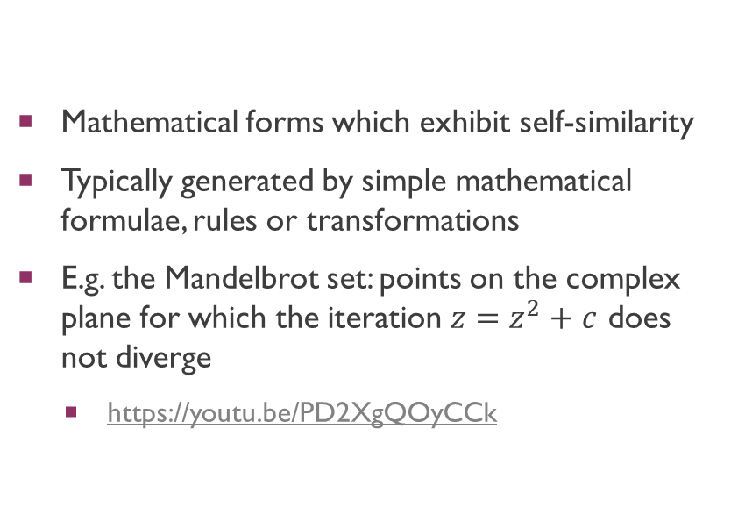
Fractals
Mathematical forms which exhibit self-similarity
Typically generated by simple mathematical formulae, rules or transformations
E.g. the Mandelbrot set: points on the complex plane for which the iteration $z=z^{2}+c$ does not diverge
https://youtu.be/PD2XgQOyCCk

Slide 19
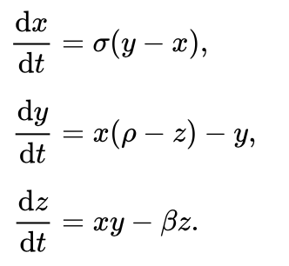
Chaos
Systems with emergence tend to be chaotic
Sensitive dependence on initial conditions
Unpredictable, even if deterministic (i.e. not random)

Slide 20
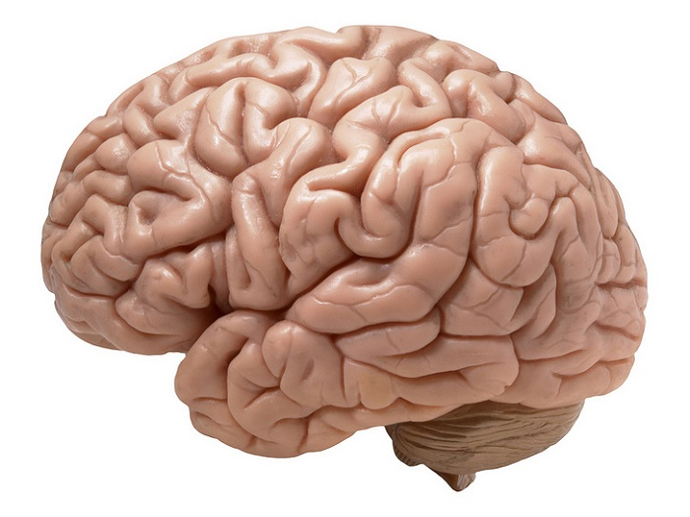
The ultimate emergence?
The human brain is composed of billions of neurons
A neuron is a relatively simple electro-chemical cell
From them emerge intelligence, creativity, consciousness, …

Slide 21
Using emergence
Emergence can mean that simple systems combine to give complex properties
This can be a double-edged sword in terms of AI design
Pro: rich behaviours can emerge from relatively simple designs
Con: difficult to predict or design the behaviour that will emerge

Slide 22
Workshop

